Slide 1
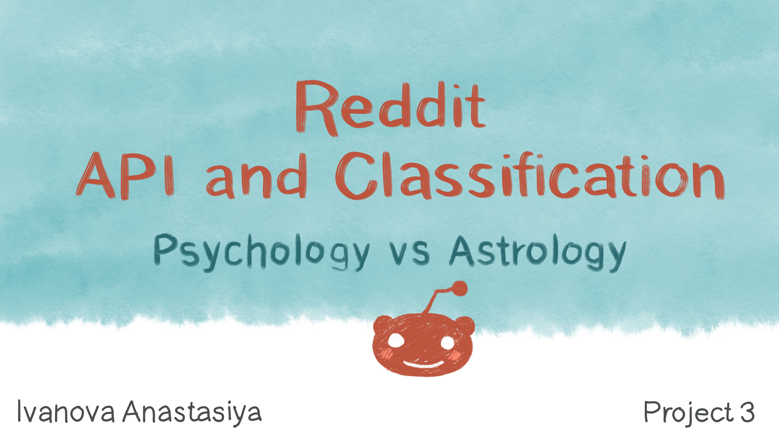

Slide 2
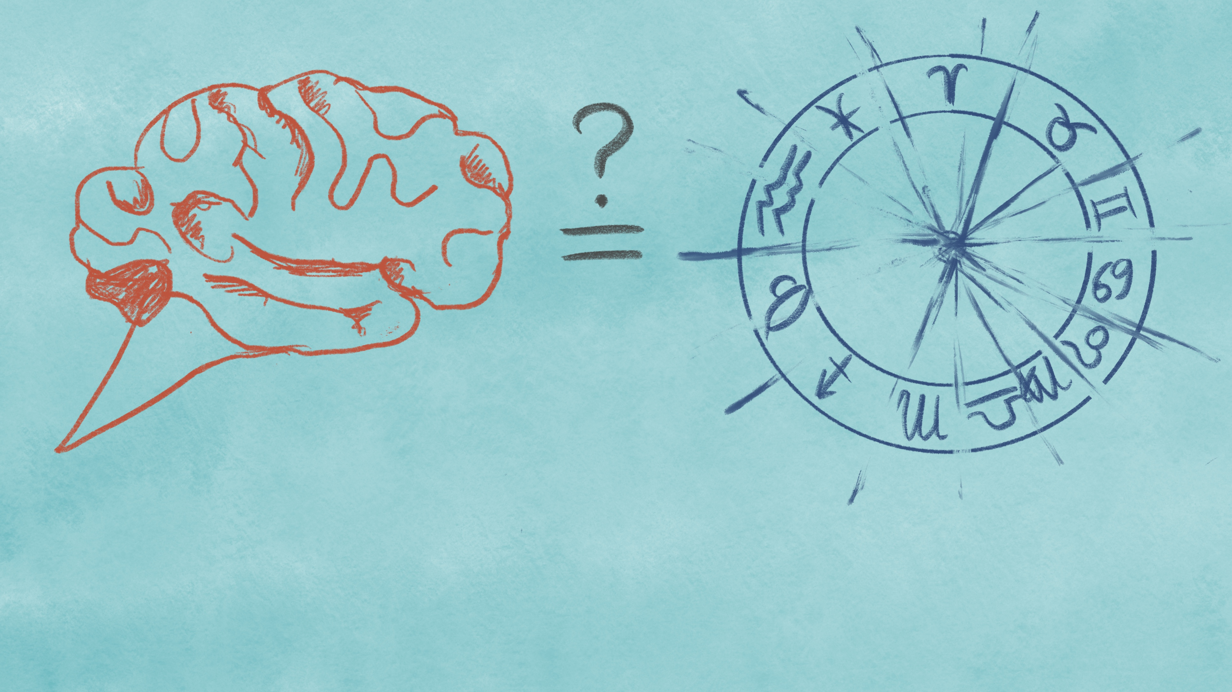
Some people claim that psychology and astrology are very similar fields
Others think that psychology is science while astrology is a pseudoscience and they do not have any close relationship.

Slide 3

Questions

Slide 4

Answer the following questions:
Distinguish
Distinguish post about psychology and astrology based on the text?
Vocabulary
Do psychology and astrology have a specific vocabulary?
Community
Does the activity of the community members in subreddits differ?
Scientific
Do psychological posts contain scientific words?

Slide 5
Evaluation of success

Slide 6
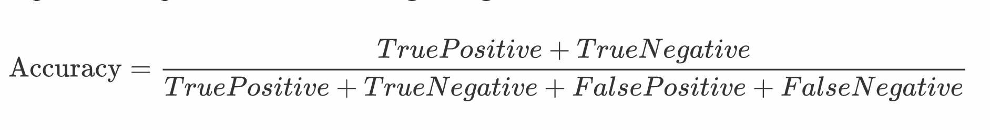

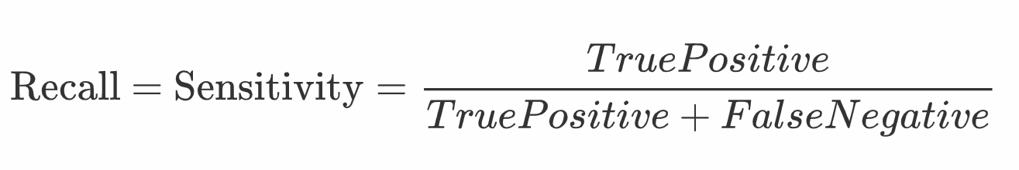
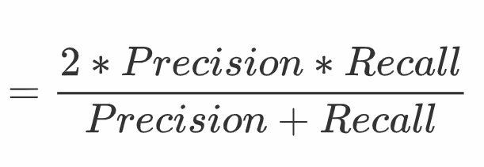
Evaluation
F1

Slide 7

Exploratory Data Analysis

Slide 8
Number of posts:
astrology 907 rows
psychology 735 rows

Slide 9
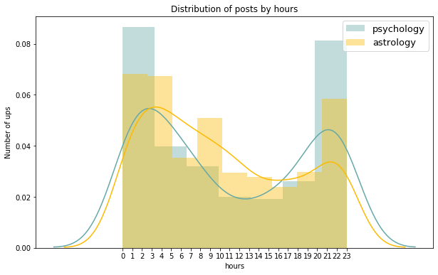
Posts in the dataset were published between
2020-05-13 21:05:19 and 2020-02-28 05:16:12.

Slide 10
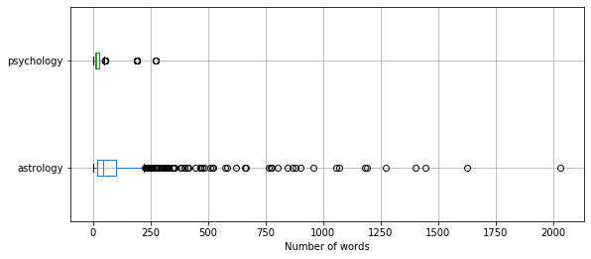
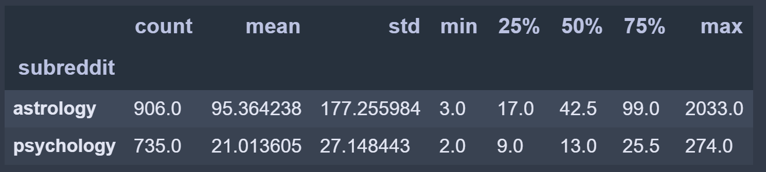
Astrology subreddit's posts have significantly more words than Psychology.

Slide 11
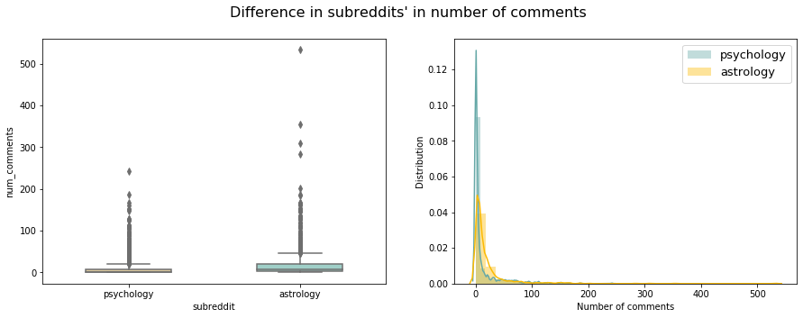
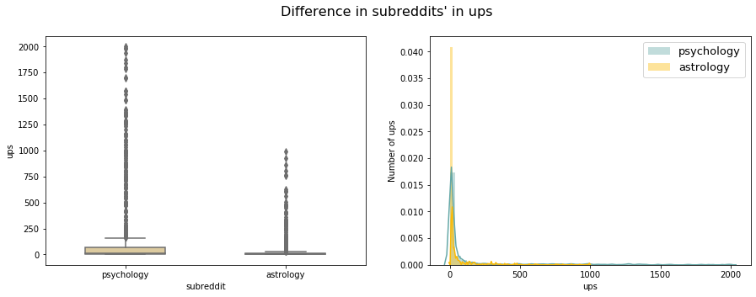
Difference in subreddits' in number of comments
Difference in subreddits' in ups

Slide 12
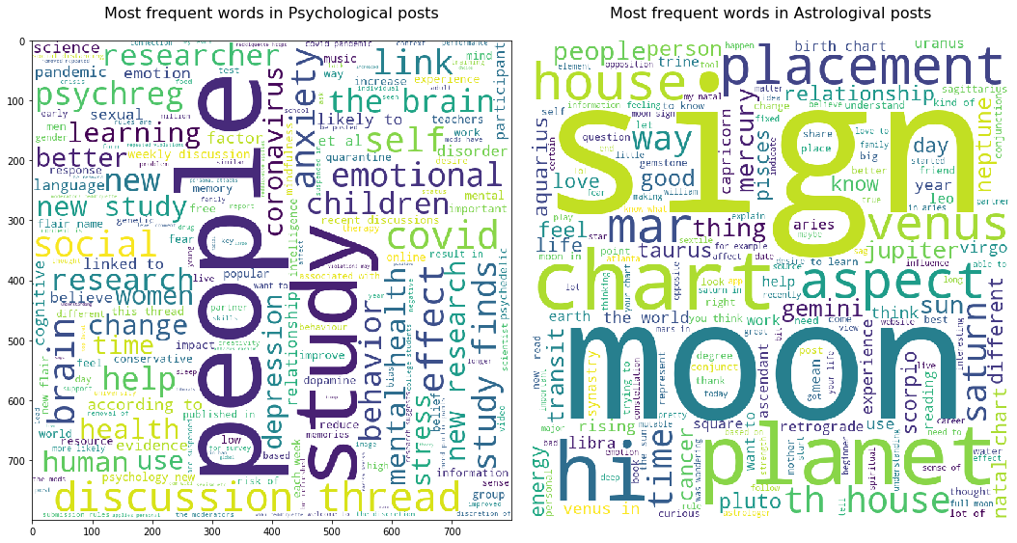

Slide 13
Modeling

Slide 14
55.2%
Baseline model

Slide 15

Evaluation
F1

Slide 16
TfidfVectorizer LogisticRegression Best model
Vectorizer | Model | Cross_val_scores train (accuracy) | Train accuracy | Test accuracy | Test precision | Test recall | Test f1
TfidfVectorizer | MultinomialNB | 0.902, 0.927, 0.915, 0.909, 0.884 | 0.993 | 0.921 | 0.984 | 0.837 | 0.904
TfidfVectorizer | LogisticRegression | 0.97, 0.933, 0.945, 0.957, 0.896 | 0.998 | 0.945 | 0.924 | 0.956 | 0.94
TfidfVectorizer | KNeighborsClassifier | 0.866, 0.89, 0.909, 0.884, 0.878 | 0.913 | 0.904 | 0.965 | 0.815 | 0.883

Slide 17
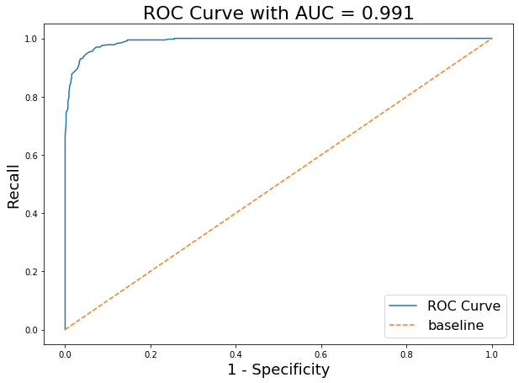
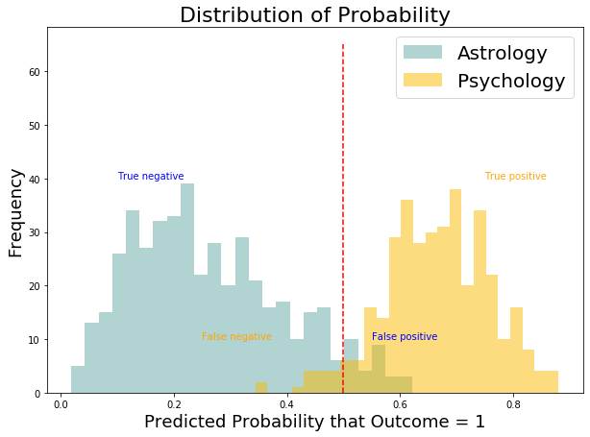
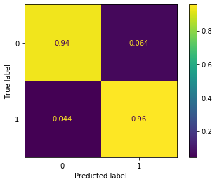

Slide 18
Word coefficients

Slide 19

word | coef | exp_coef
chart | -2.601682 | 0.074149
moon | -2.584769 | 0.075414
house | -2.293753 | 0.100887
sign | -2.131883 | 0.118614
know | -1.943406 | 0.143215
saturn | -1.714446 | 0.180063
planets | -1.673879 | 0.187518
venus | -1.646902 | 0.192646
placements | -1.471980 | 0.229471
like | -1.425828 | 0.240309
mars | -1.415241 | 0.242867
signs | -1.285386 | 0.276544
aspects | -1.277923 | 0.278615
think | -1.239005 | 0.289672
sun | -1.220196 | 0.295172
Negative coefficients

Slide 20

word | coef | exp_coef
brain | 1.825749 | 6.207442
study | 1.793729 | 6.011832
covid | 1.593490 | 4.920891
psychreg | 1.192753 | 3.296143
research | 1.191482 | 3.291956
social | 1.050195 | 2.858208
finds | 0.987221 | 2.683765
health | 0.967211 | 2.630598
people | 0.867871 | 2.381834
mental | 0.830564 | 2.294612
children | 0.808631 | 2.244833
cognitive | 0.799526 | 2.224487
anxiety | 0.790690 | 2.204918
behavior | 0.773993 | 2.168407
women | 0.712393 | 2.038864
Positive coefficients

Slide 21
Misclassification

Slide 22
Misclassified Astrological posts
astr_proba | psy_proba | subred | predict | text | num_comments | ups | len_text
0.468920 | 0.531080 | 0 | 1 | my university paid me to study astrology hi ev... | 16 | 68 | 154
0.404068 | 0.595932 | 0 | 1 | an astrological saga i am writing | 1 | 1 | 6
0.393937 | 0.606063 | 0 | 1 | future of the single european currency what wi... | 5 | 1 | 17
0.487269 | 0.512731 | 0 | 1 | trump s impeachment and the eclipses | 1 | 0 | 6
0.449905 | 0.550095 | 0 | 1 | harry styles astrological profile and future a... | 1 | 0 | 13
0.468126 | 0.531874 | 0 | 1 | til that mutable has that same root as mutate ... | 20 | 17 | 11
0.496673 | 0.503327 | 0 | 1 | haha well at least we figured out what the thi... | 2 | 2 | 11

Slide 23
Misclassified Psychological posts
astr_proba | psy_proba | subred | predict | text | num_comments | ups | len_text
0.527827 | 0.472173 | 1 | 0 | time to kill the scientific zombie that is the... | 0 | 2 | 13
0.510812 | 0.489188 | 1 | 0 | what a friend is upset validating their feelin... | 6 | 21 | 16
0.639311 | 0.360689 | 1 | 0 | connectedness to nature is good for us and for... | 0 | 12 | 11
0.534877 | 0.465123 | 1 | 0 | did mayor pete s youthful face lose him votes ... | 0 | 2 | 19
0.575771 | 0.424229 | 1 | 0 | free bathrooms in starbucks cellphone location... | 6 | 6 | 28
0.552107 | 0.447893 | 1 | 0 | are you big enough to apologize | 0 | 11 | 6
0.547903 | 0.452097 | 1 | 0 | looking at your phone at work might make you e... | 44 | 799 | 12

Slide 24
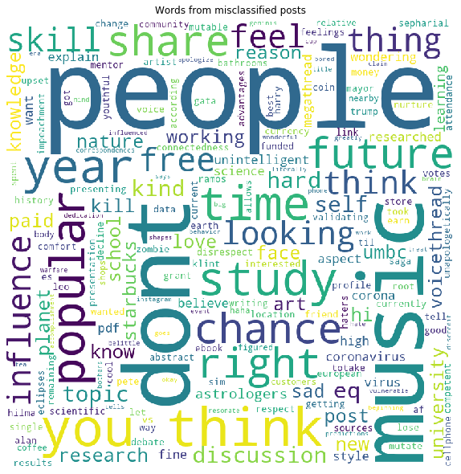

Slide 25
Conclusion

Slide 26
820 new posts from two subreddits: r/psychology/ and r/astrology/
were classified with accuracy of 94.5 %.
Predictive words of subreddits where
identified based on a coefficient of the model.

Slide 27
Answering the questions

Slide 28
Answer the following questions:
Distinguish
Yes, it is. Our model classified correctly 94.5 % of new unlabeled posts.
Vocabulary
1.People who write posts for an astrological subreddit prefer to use more words (and sometimes even more than 1000 words) than those who writing posts for a psychological subreddit.
2.Astrological community writing more comments to posts than psychological.
3.Psychological community is more than astrological rates posts with ups. 4.Psychological posts were published later at night than astrological. Morning activity (from 8 to 10 a.m) can be seen for astrological subreddit.
Community
Yes, they do. Specific words for Psychology: brain, psychreg, social, health, mental, cognitive, anxiety, behavior. Specific words for Astrology: house, sign, saturn, planets, venus, placements, mars, signs, sun.
Scientific
scientific vocabulary which distinguish psychology from astrology: study, research.

Slide 29
Further research suggestions
Based on the model limitation some suggestions for further research can be made:
More data
Different balance of classes.
Use additional features.
Stop words removing/addition
Filter posts with a small number of words in selftext and title.
Use more advanced models.
Ideas for additional research:
Exploring posts with a high number of commentaries and ups.
Expend a model for more broad classification:
Distinguishing psychological posts from other
posts with different topics.
Explore how psychology differs from
science subreddit.
Add more than two classes.
Build a model for posts with a small length of texts.
Extend dataset with posts which were published during a longer period of time.
Deploy the model for general publish usage.

Slide 30
Who Can Use the Model?

Slide 31
The resulting model can be useful for
Layman people who cannot decide if the information comes from psychological science or astrological pseudoscience.
Moderators of r/psychology/ and r/astrology/ subreddits to save time from manual sorting of these two classes.

Slide 32
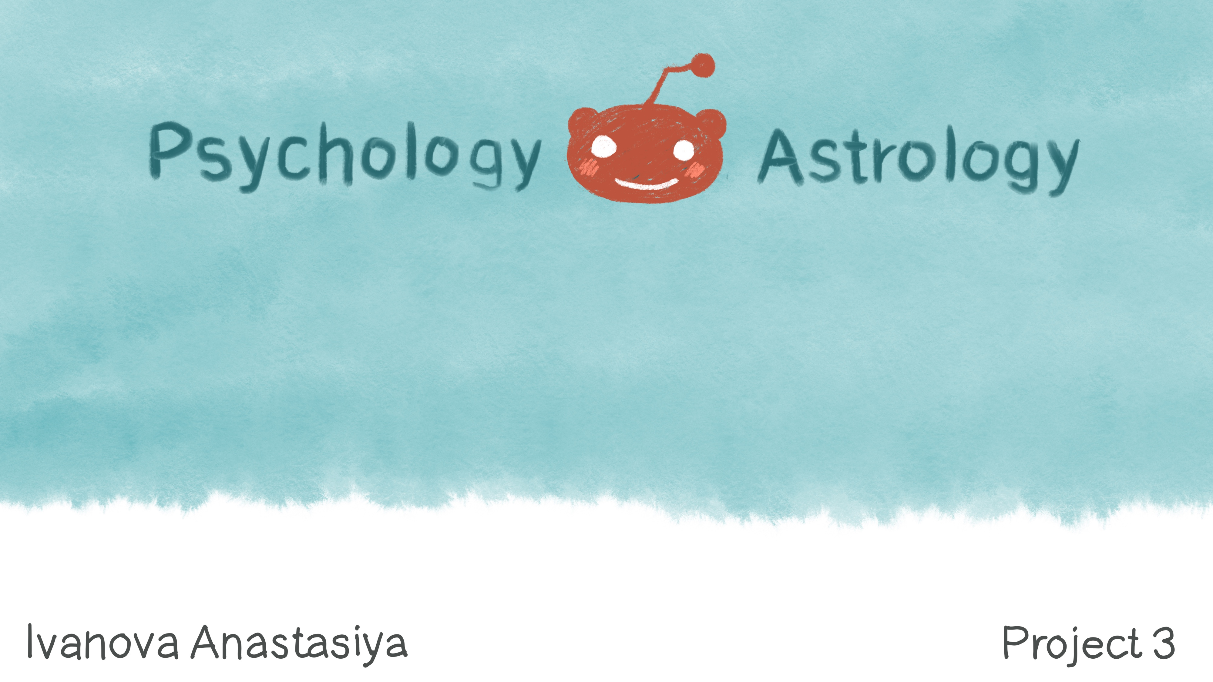
Questions?

